Slide 1

Module 2- Big Data Infrastructure
Hadoop Ecosystem-HIVE

Slide 2

Hadoop Ecosystem-HIVE
Review of Sterday…..
How HIVE is different from RDBMS?
Major points
What is HIVE?
How HIVE interacts with HDFS?
Difference between HIVEQL and SQL
HIVE Datatypes

Slide 3
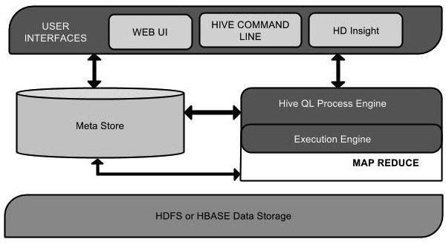
What is HIVE
BIG DATA
Data is stored in HDFS
Meta Store – for schema
User submits SQL query
Converted to MR jobs
http://ewh.ieee.org/r6/scv/computer/nfic/2008/Facebook%20Hive%20by%20Ashish%20Thusoo.ppt

Slide 4
HIVE Components
BIG DATA
Execution Engine: Hadoop
ExternalInterfaces
CLI, webUI, JDBC, ODBC, Thrift
Map Reduce
HDFS
Mgmt. Web UI
Hive CLI
Browsing
Queries
Compile
Translates statement into a DAG of map-reduce jobs
DDL
Thrift API
Parser
Execution
Planner
Metastore: system catalog
Metadata about tables and data
Hive QL
SerDe: serialization, de-serialization
Read data from disk, convert to Hive format
Reverse during writes
SerDe
Thrift
Jute
JSON..
MetaStore

Slide 5
Data Model
BIG DATA
3. Partition
Part of table partitioned on values of columns
Implemented as a n HDFS subdirectory
If clicks is partitioned on column ds Data with a particular ds value 2008-03-25 will be stored in /hive/clicks/ds=2008-03-25
If further divided on ctry value US will be stored in the directory /hive/clicks/ds=2008-03-25/ctry=US.
1. Hive data stored as HDFS files
/hive/clicks
/hive/clicks/ds=2008-03-25
/hive/clicks/ds=2008-03-25/0
2. Table – similar to table in relational database
Mapped to HDFS directory
Data for table clicks is in the directory /hive/clicks
For scalability, tables divided into multiple files and directories
4. Bucket
Subdivision of partition
Divided based on hash of a specified column
Thusoo, Ashish, Joydeep Sen Sarma, Namit Jain, Zheng Shao, Prasad Chakka, Suresh Anthony, Hao Liu, Pete Wyckoff, and Raghotham Murthy. "Hive: a warehousing solution over a map-reduce framework." Proceedings of the VLDB Endowment 2, no. 2 (2009): 1626-1629

Slide 6
HIVE DATA TYPES

Slide 7
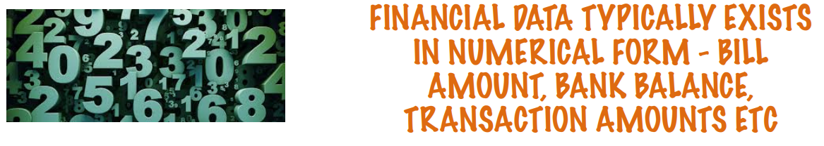
Data Types-Numbers

Slide 8
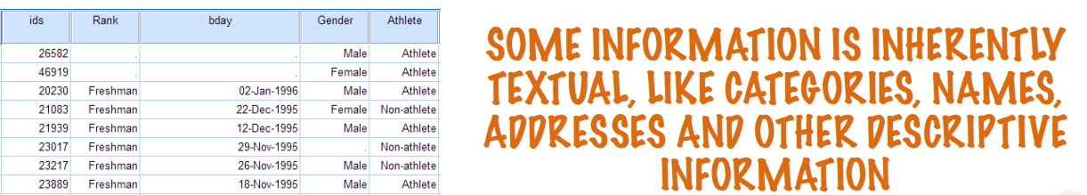
Data Types- Text

Slide 9

Data Types-Videos

Slide 10
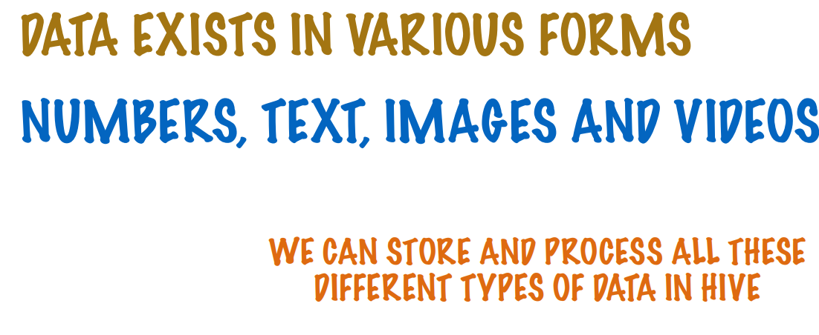

Slide 11
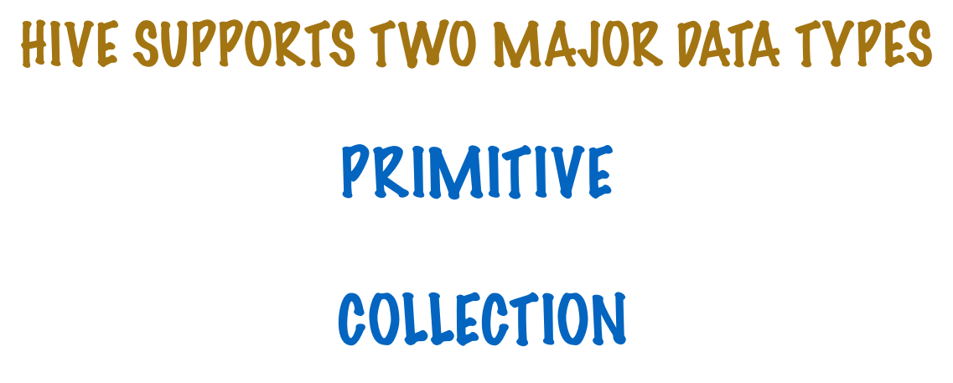

Slide 12
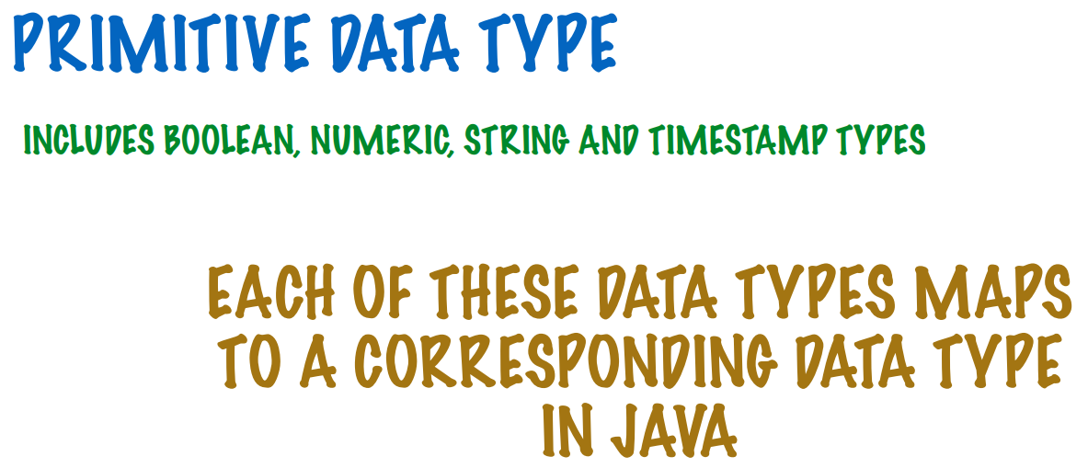

Slide 13
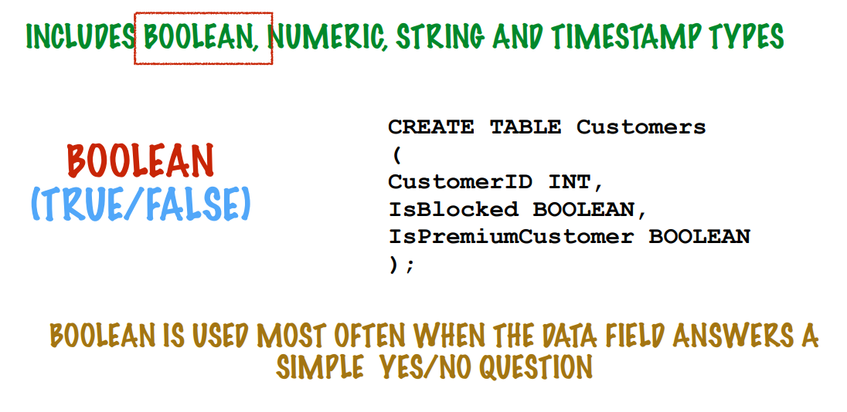

Slide 14
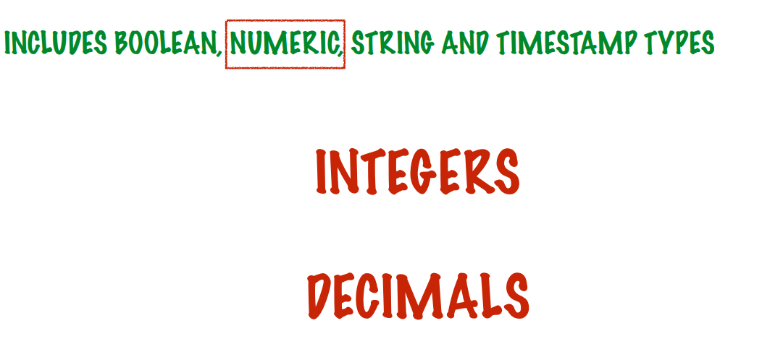

Slide 15
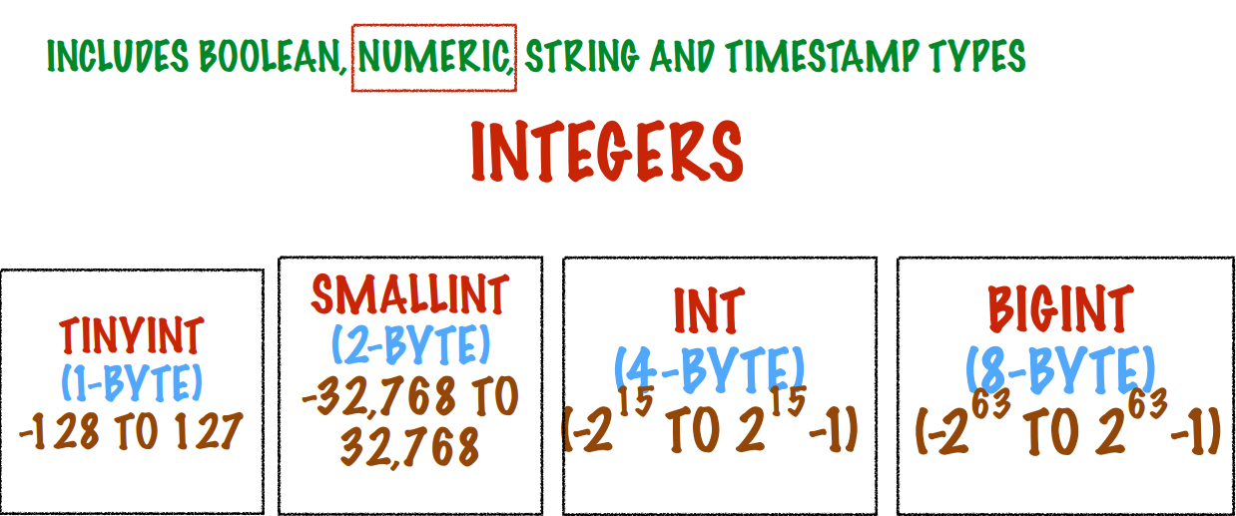

Slide 16
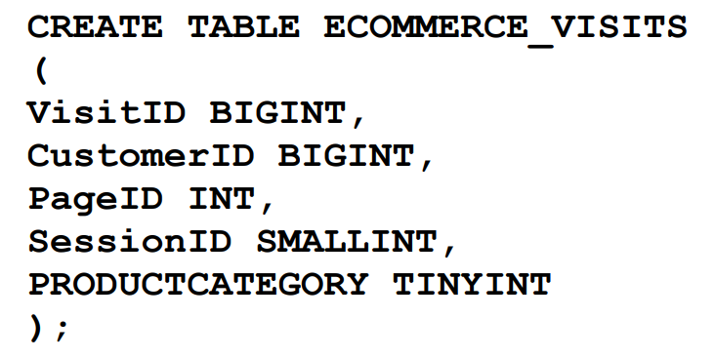

Slide 17
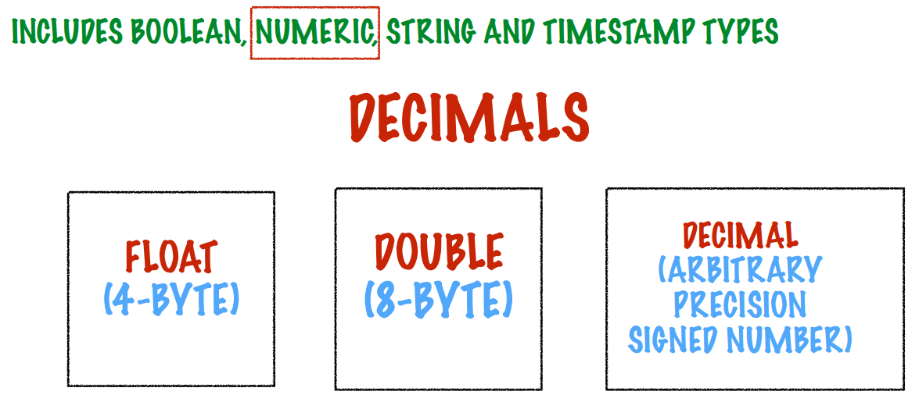

Slide 18
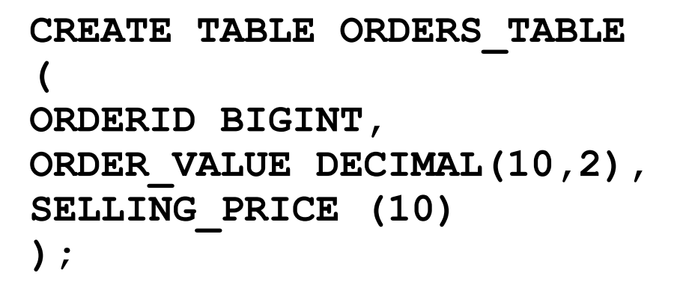

Slide 19
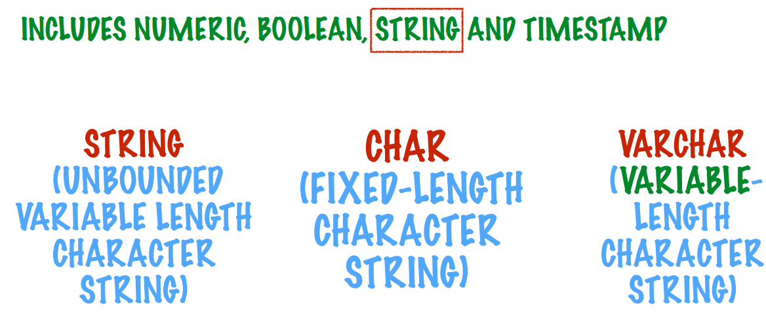

Slide 20
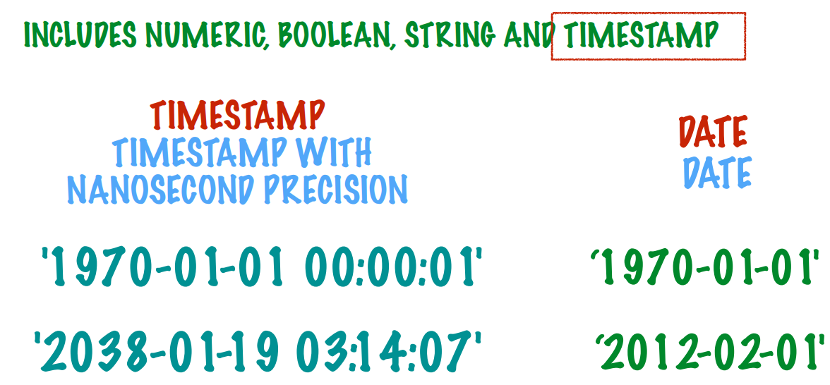

Slide 21
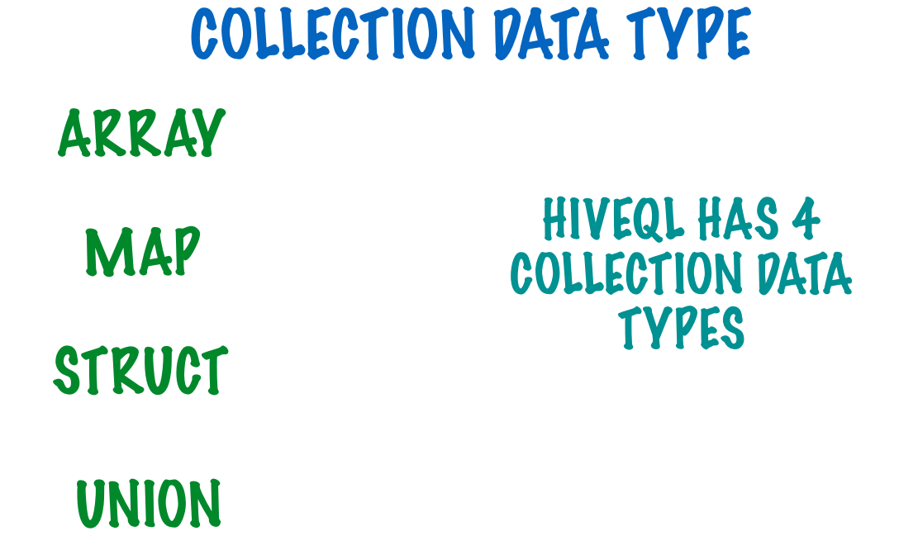

Slide 22
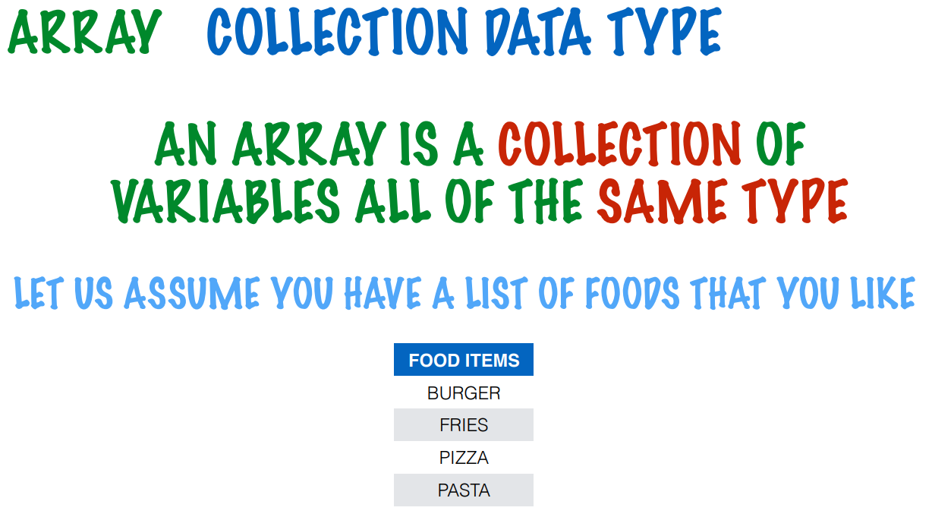

Slide 23
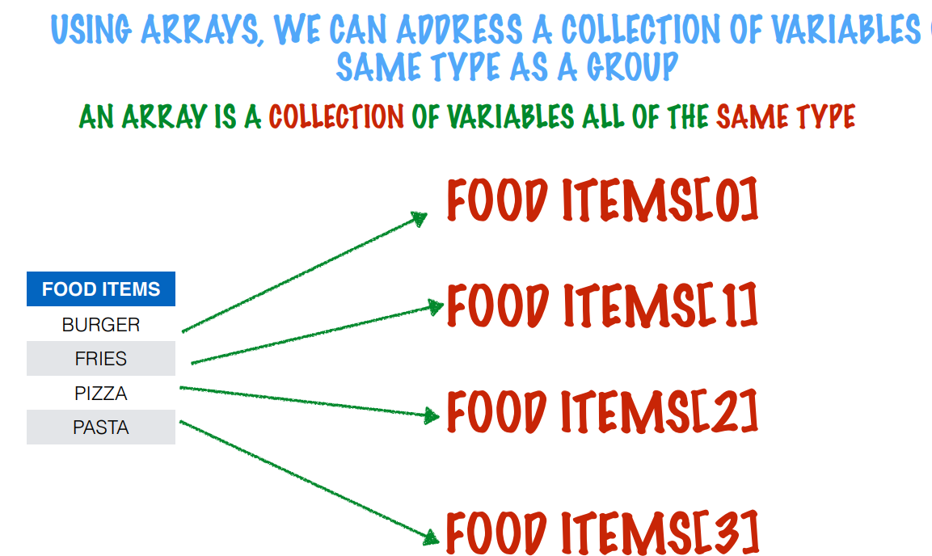

Slide 24
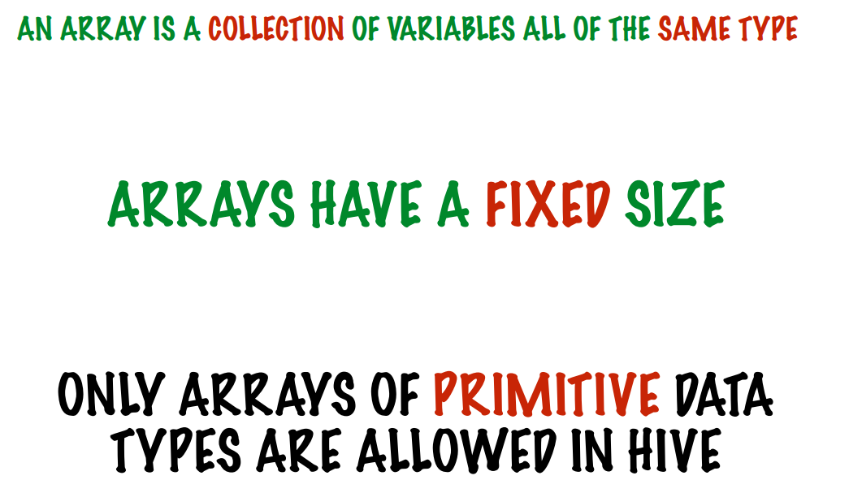

Slide 25
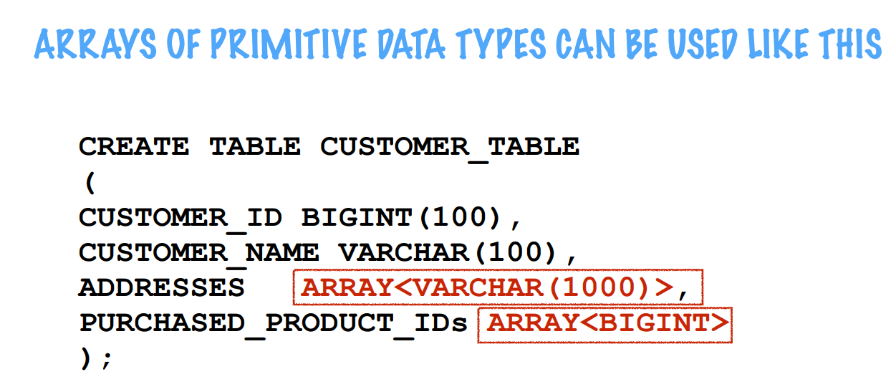

Slide 26
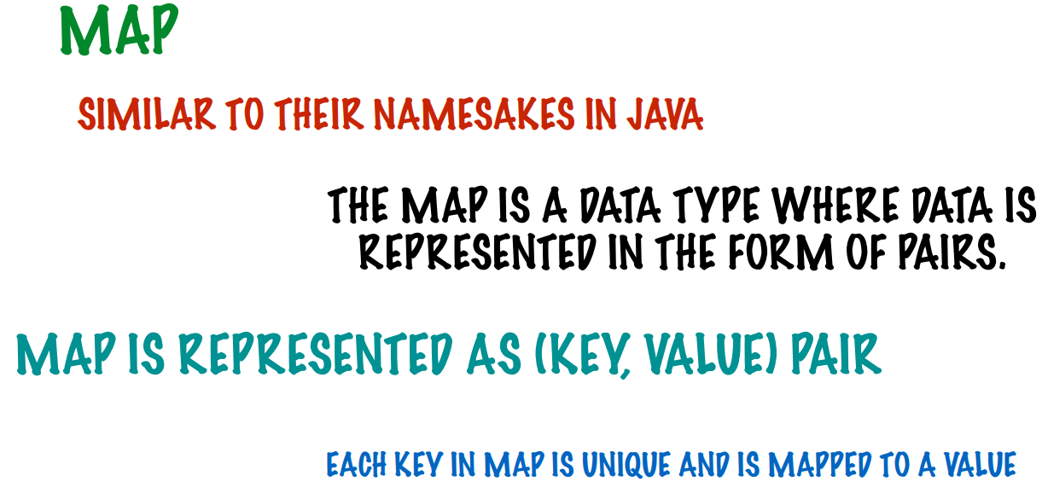

Slide 27
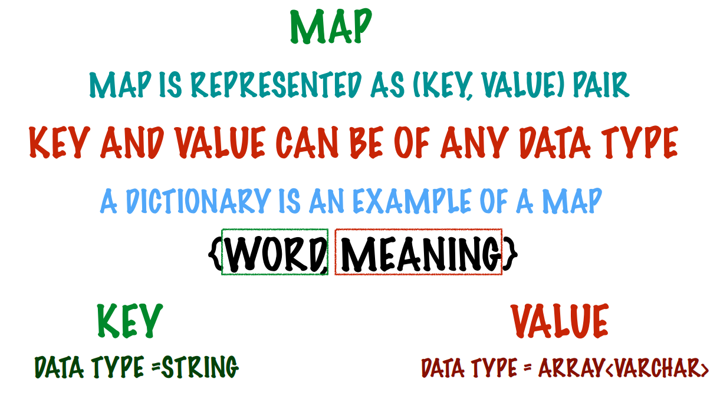

Slide 28
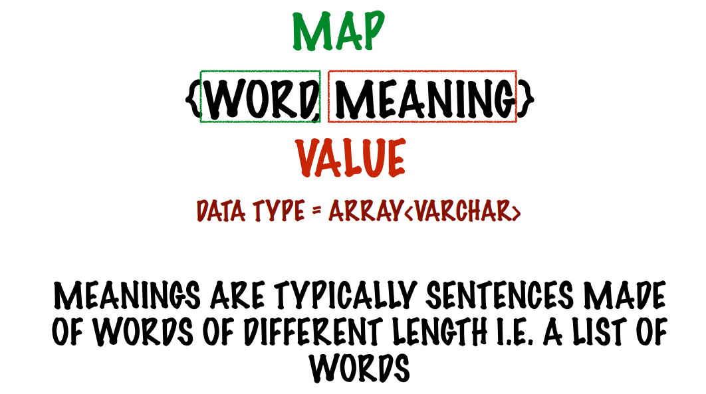

Slide 29
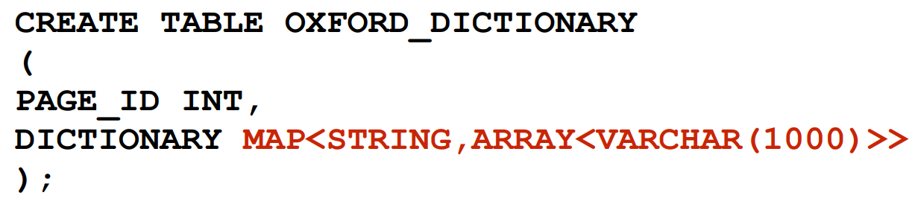

Slide 30
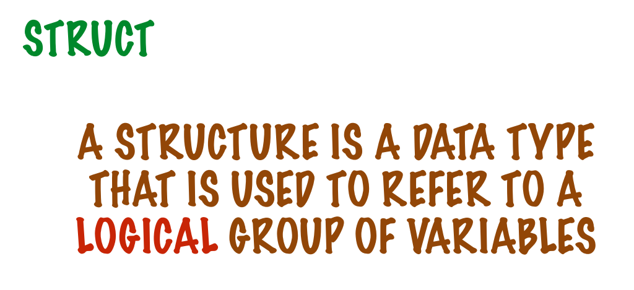

Slide 31
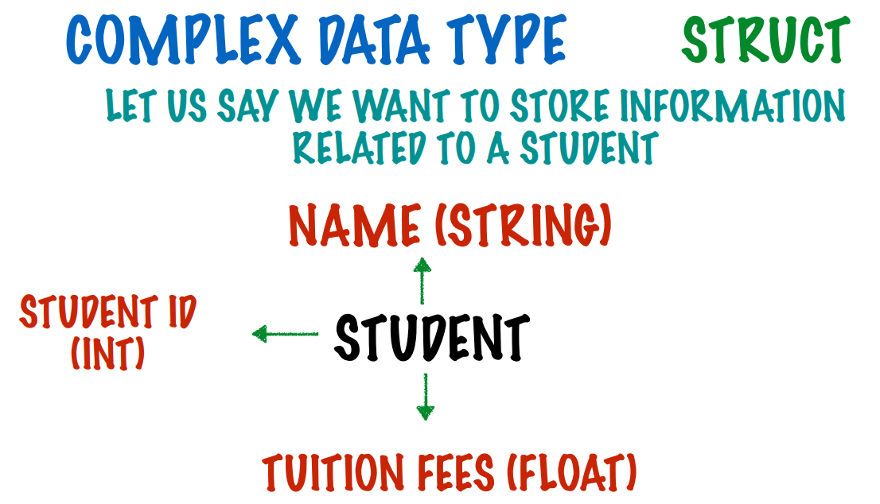

Slide 32
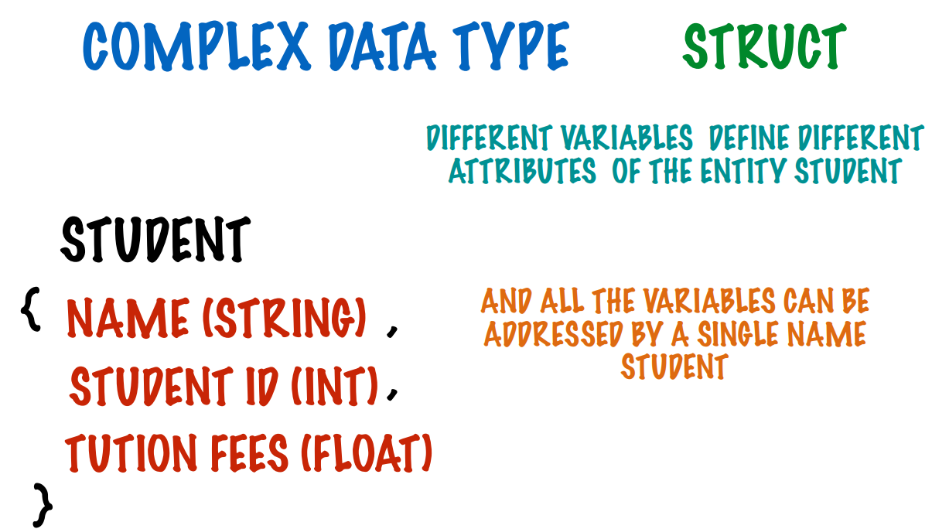

Slide 33
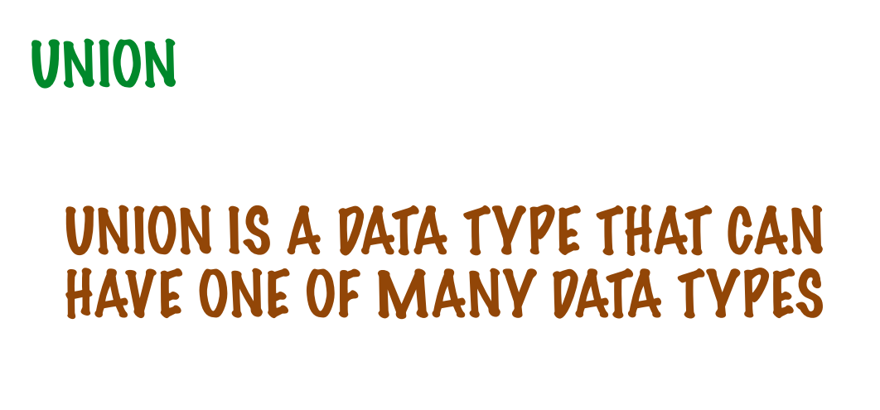

Slide 34
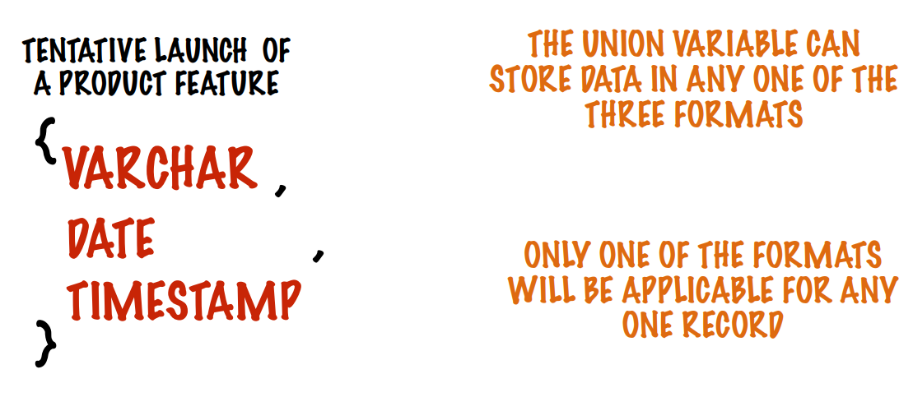

Slide 35
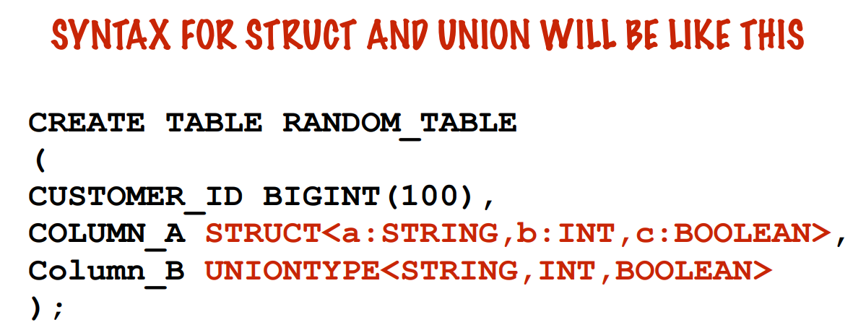

Slide 36
CREATING TABLES

Slide 37
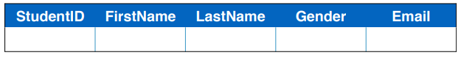

Slide 38
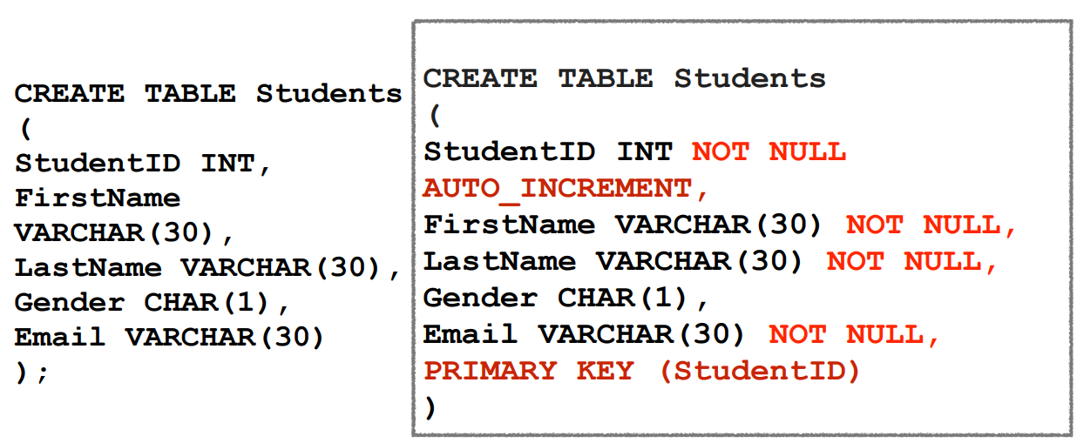

Slide 39


Slide 40
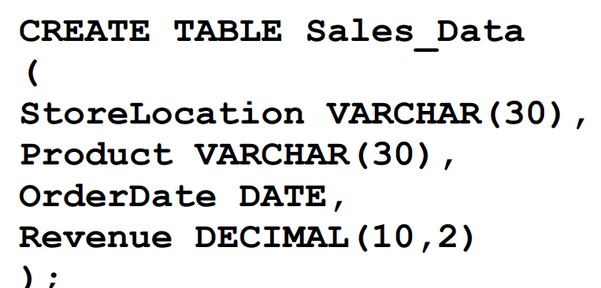

Slide 41
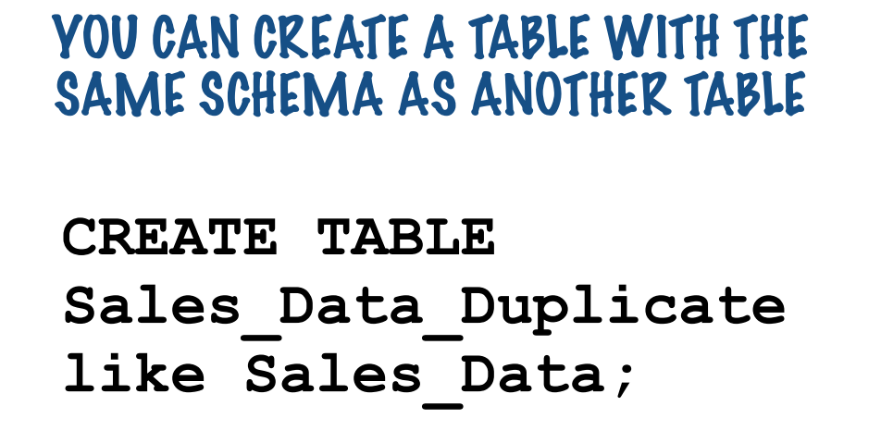

Slide 42
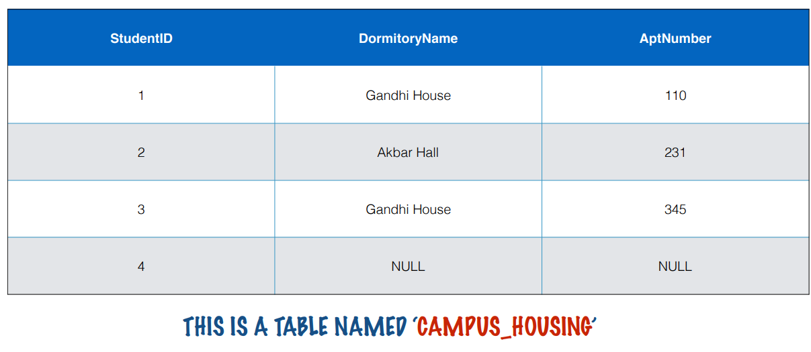

Slide 43
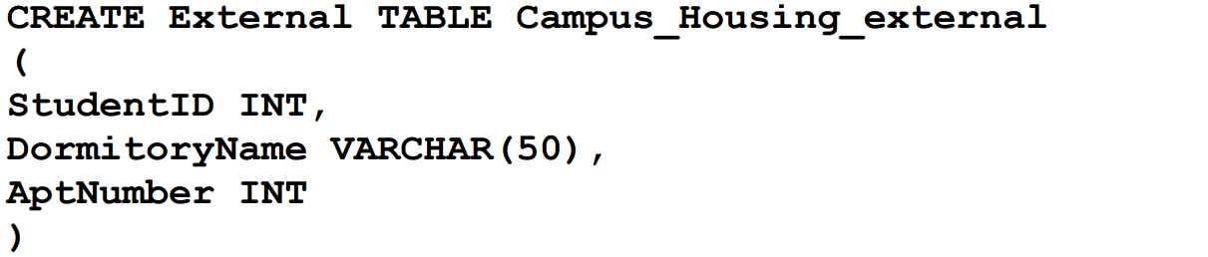

Slide 44
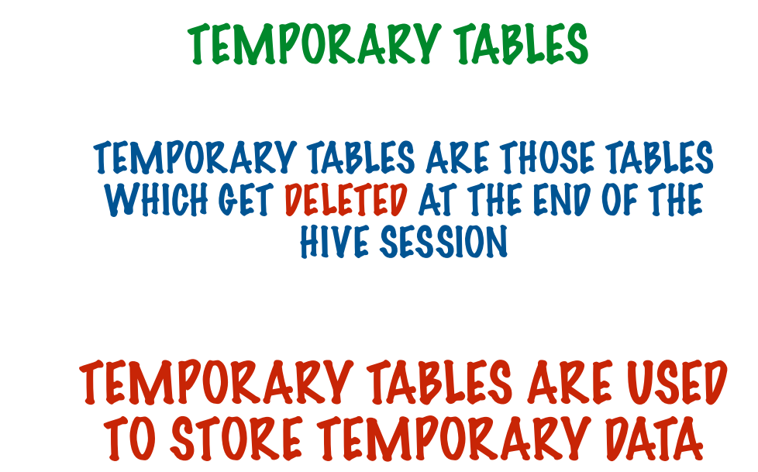

Slide 45


Slide 46



Slide 47
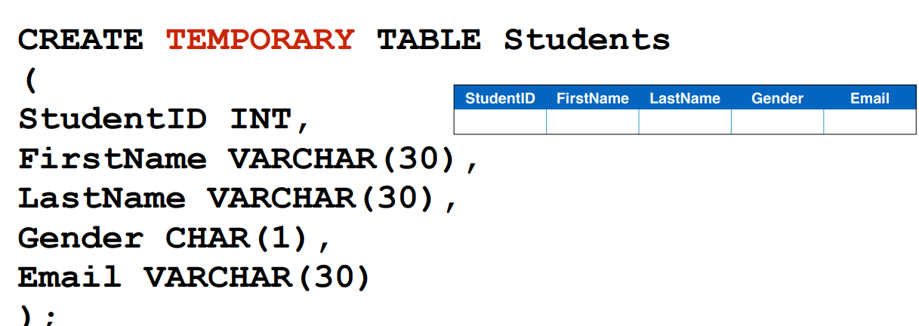

Slide 48


Slide 49
THANK YOU
“WORLD IS ONE BIG DATA PROBLEM”
“TORTURE THE DATA AND IT WILL CONFESS TO ANYTHING”

